Slide 1
DEEP LEarNiNg MastEr Class
Day-7

Slide 2
01
Backpropagation
Concept

Slide 3
Backpropagation
we initialize weights with some random values or any variable
It’s not mean that whatever weight values we have selected will be correct
The error value may be huge
We explain the model to change the parameters (weights), such that error becomes minimum using Backpropagation
The Backpropagation algorithm looks for the minimum value of the error function in weight space using a technique called the delta rule or gradient descent. The weights that minimize the error function is then considered to be a solution to the learning problem

Slide 4
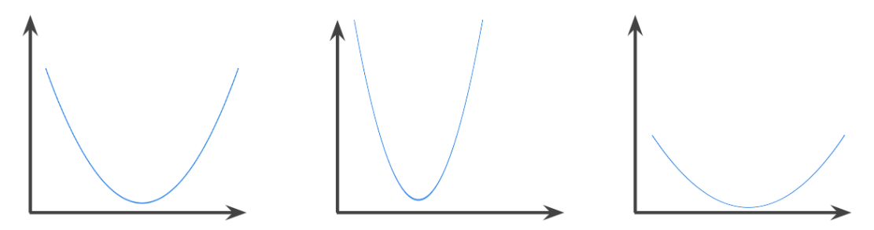
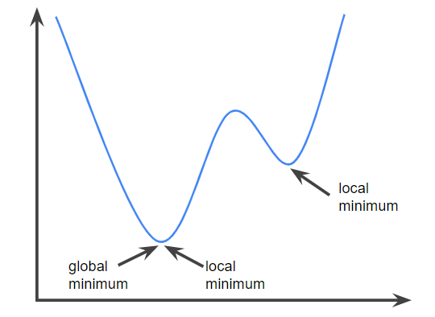
Deep Learning Terminology - 1
convex function
A function in which the region above the graph of the function is a convex set
It is shaped something like the letter U
has exactly one local minimum point, which is also the global minimum point.

Slide 5
Deep Learning Terminology - 2
Multilayer Perceptron
An entry point towards complex neural nets where input data travels through various layers of artificial neurons
Every single node is connected to all neurons in the next layer which makes it a fully connected neural network
Input and output layers are present having multiple hidden Layers
It has a bi-directional propagation i.e. forward propagation and backward propagation
Used for deep learning [due to the presence of dense fully connected layers and back propagation]

Slide 6
Deep Learning Terminology - 3
Artificial Neural Network
It is a group of multiple perceptron or neurons at each layer
ANN is also known as a Feed-Forward Neural network because inputs are processed only in the forward direction
The network may or may not have hidden node layers, making their functioning more interpretable

Slide 7
—Asset & Liabilities
Short bytes – D6
Asset is something that puts money in your pocket
Liability is something that takes money out of your pocket

Slide 8
Short bytes – D7
HAVE A CLEAR VISION of the future you want to create
NEVER COMPLAIN about anything you can't change or unwilling to change
LEARN SOMETHING NEW TODAY that will take you closer to your goal tomorrow
BREAK A SWEAT EVERY DAY through physical exercise, Emotion is created by motion. This unlocks great ideas, creativity and genius
GIVE AWAY that which you want to get more of
DON'T BE CHEAP on your journey to greatness
SIMPLIFY EVERYTHING
DON'T SETTLE for 'good enough'; strive to achieve EXCELLENCE in everything you do
DONT BE BUSY - BE effective, efficient & productive
TAKE RESPONSIBILITY for everything. Be in control and make things happen
LEAD BY EXAMPLE. Never ask or expect anyone to do anything you are not willing to do yourself
"I'm destined for greatness. Success is my responsibility I CAN ACHIEVE ANYTHING I PUT MY MIND TO.

Slide 9
Thanks!
Thanks!
Follow Me on LinkedIn : Link in Description
+91 7305845758
Pantechsolutions.net
Ask Your Friends to Participate on this Event

